Slide 1

IBM Research
Quantum Computing:
A Paradigm Shift
Alessandro Curioni, PhD
IBM Fellow
Vice President, IBM Research Europe and Africa
Director, IBM Research Europe – Zurich
@ale_curioni

Slide 2


Slide 3


Slide 4


Slide 5


Slide 6


Slide 7


Slide 8


Slide 9


Slide 10
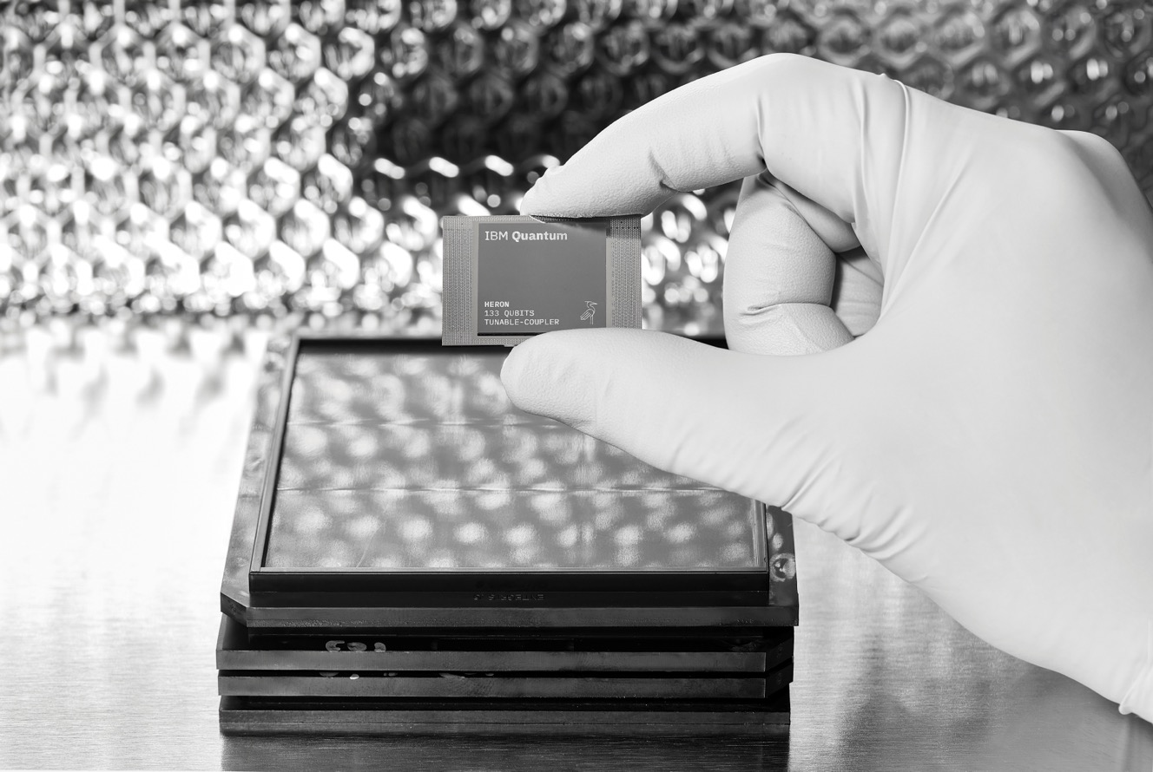

Slide 11
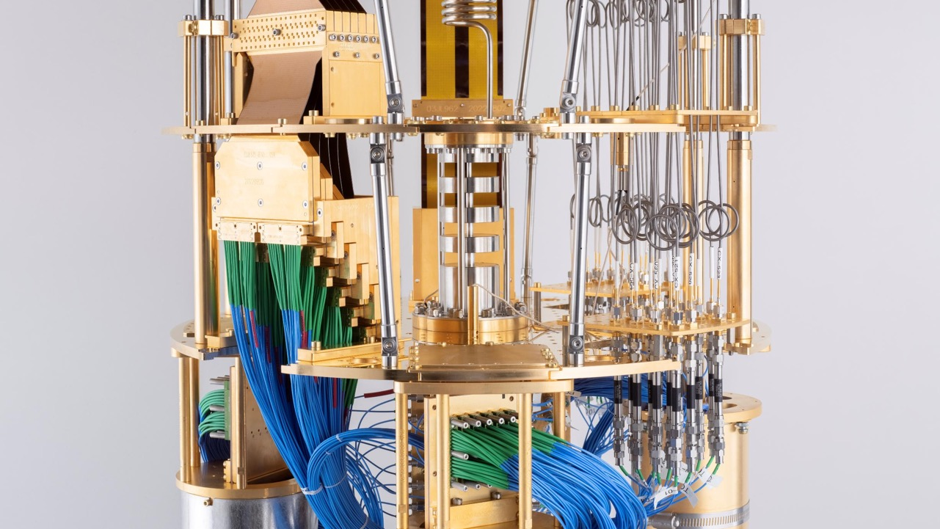

Slide 12
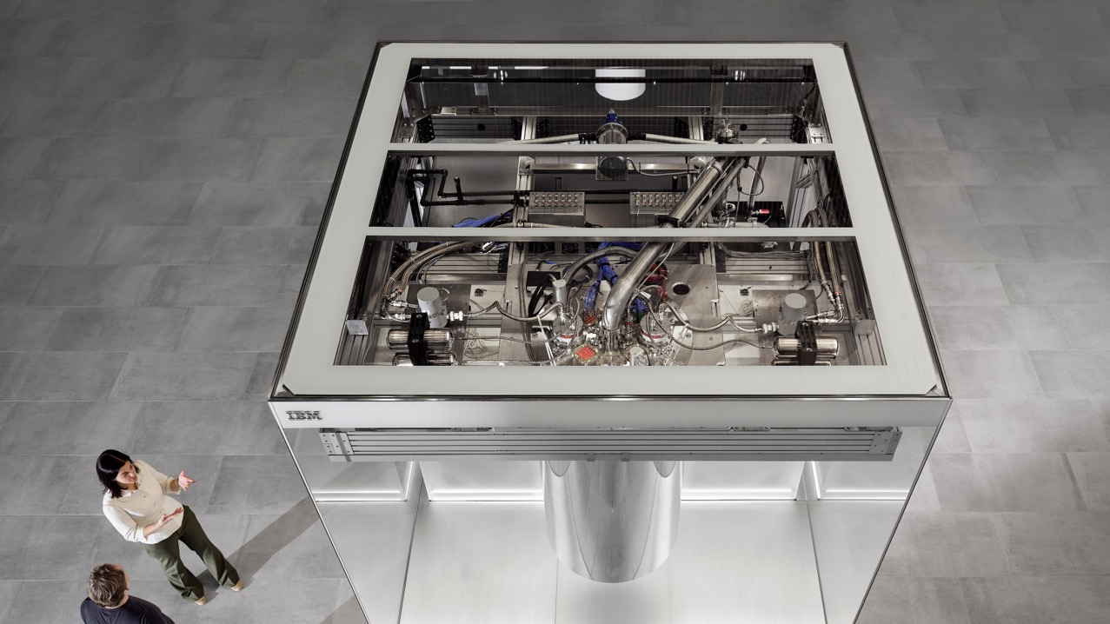

Slide 13


Slide 14
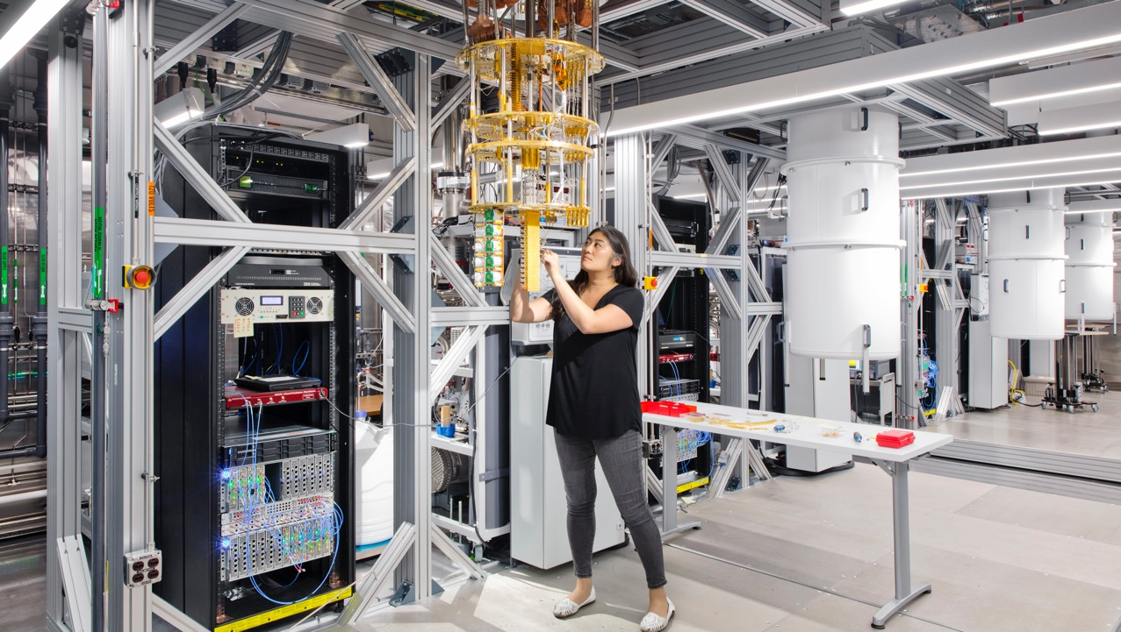

Slide 15


