Slide 1


EXECUTIVE
SUMMIT 2025
Change Beyond Technology
May 21 2025 Hilton Hotel, Moussala Hall

Slide 2
Deep Dive in
SIEM | SOAR | DBFF
ЛЕКТОР
Petromir Ivanov | Manager Enterprise infrastructure solutions and services departmentSenior, CNSYS PLC

Slide 3
Advanced Searching in
IBM QRADAR SIEM
Petromir Ivanov, CNSYS PLC

Slide 4
Agenda
Ariel search and AQL
Advanced search techniques
Best practices

Slide 5
The basics
Ariel – Proprietary flat file write-once-read-many database and search engine, contains most of security data processed by QRadar. Data is organized in multiple DBs with the following on-disk structure
/store/ariel/[db]/[db_specific_structure1]/…/[year]/[month]/[day]/[hour]/
file1
file2
…
fileN
PostgreSQL – Contains configuration data, meta data and some security artifacts such as Offenses, Assets, Vulnerabilities, Reference Data etc.

Slide 6
Ariel features
Fast and scalable search engine – multithreading, local in-memory aggregations with ability to spill over to disk and to network if needed, vertical and horizontal scalability
Built-in pluggable data compression (zstd, lz4, gzip) and communication compression (lz4)
Efficient optimized indexing with compression
AQL – SQL-like query language with a subset of ANSI-SQL feature set, functionality expandable via Custom Functions
One of the design goals – a single search should be able to execute as fast as the hardware allows by utilizing all allocated system resources, if required and possible

Slide 7
Ways of searching
Classic UI
  Basic search – visual query building
  Advanced Search – using Ariel Query Language (AQL)
  Quick Filter
REST API (AQL)
New search experience – Analyst Workflow application (Visual + AQL builder)
/opt/qradar/bin/ariel_query (REST API/AQL based CLI)

Slide 8
AQL
[SELECT *, column_name1, column_name2, … , column_nameN]
[FROM table_name]
[WHERE condition clauses]
[GROUP BY column_reference*]
[HAVING condition clause]
[ORDER BY column_reference*]
[LIMIT numeric_value]
[PARAMETERS list]
[TIMEFRAME]
NOTES:
- Mandatory operators are in red, everything else is optional.
- By default, advanced searches without a timeframe executed from the UI query against the last 5 minutes of Ariel data, while from the API query the last 1 minute.
*column_reference: When you use a GROUP BY or ORDER BY clause to sort information, to make a meaningful query it is required to reference column_names from your existing SELECT statement.

Slide 9
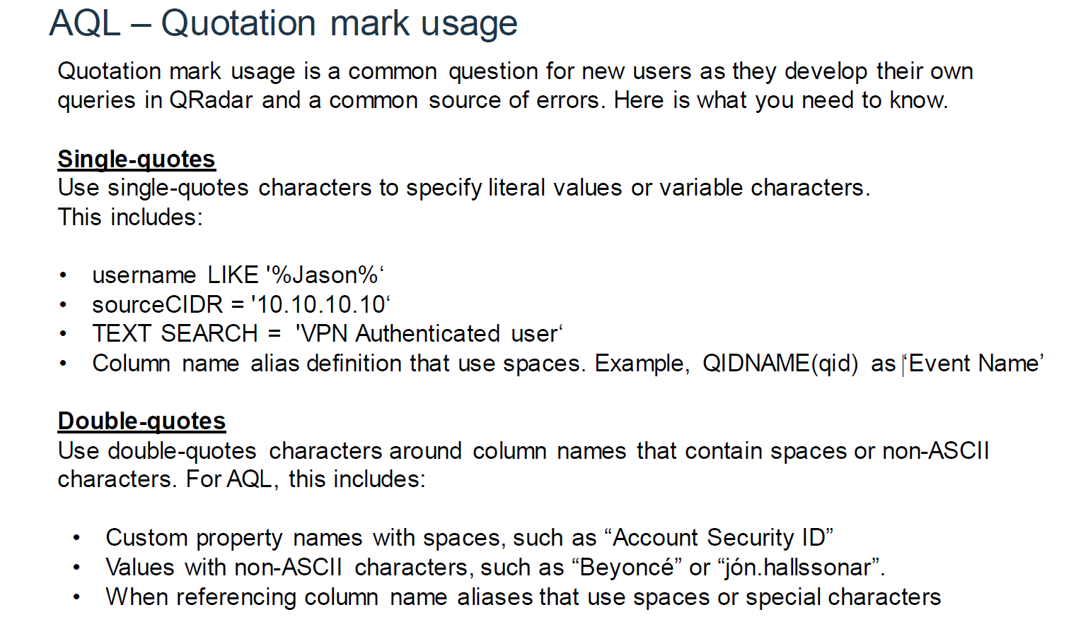

Slide 10
Regex vs. QuickFilter
Contains / matches / LIKE / MATCHES – all involve a Java Regex execution. Regex execution can be computationally complex and is unlikely to result in great search performance on large inputs.
Quick Filter – based on Apache Lucene FTS library. Creates an index and uses it for very quick text search capabilities. Trades off preprocessing and index creation resources for significantly faster search. Requires additional disk space to store the index, usually in range of 30% of the size of the uncompressed payload size.

Slide 11
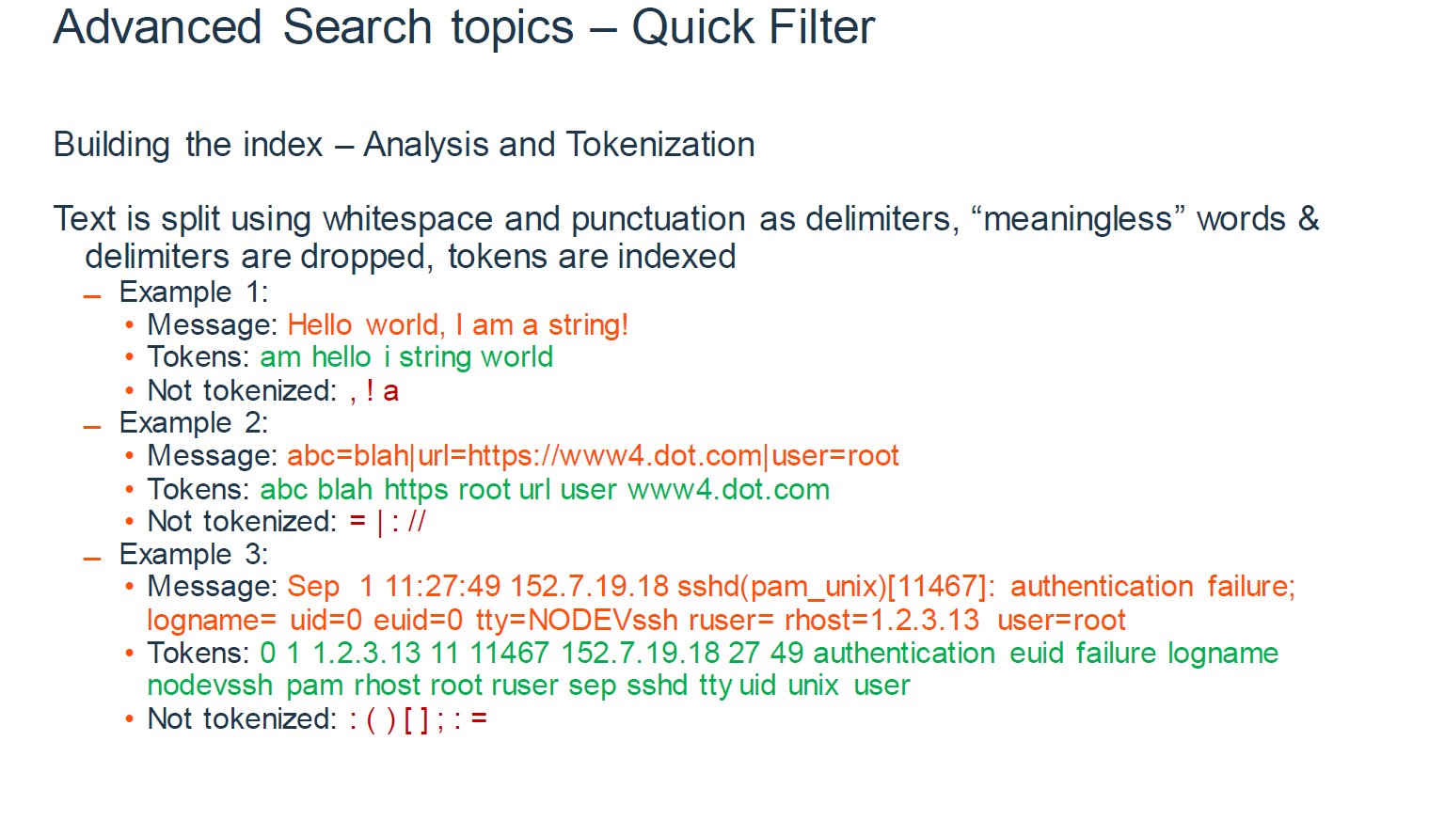

Slide 12
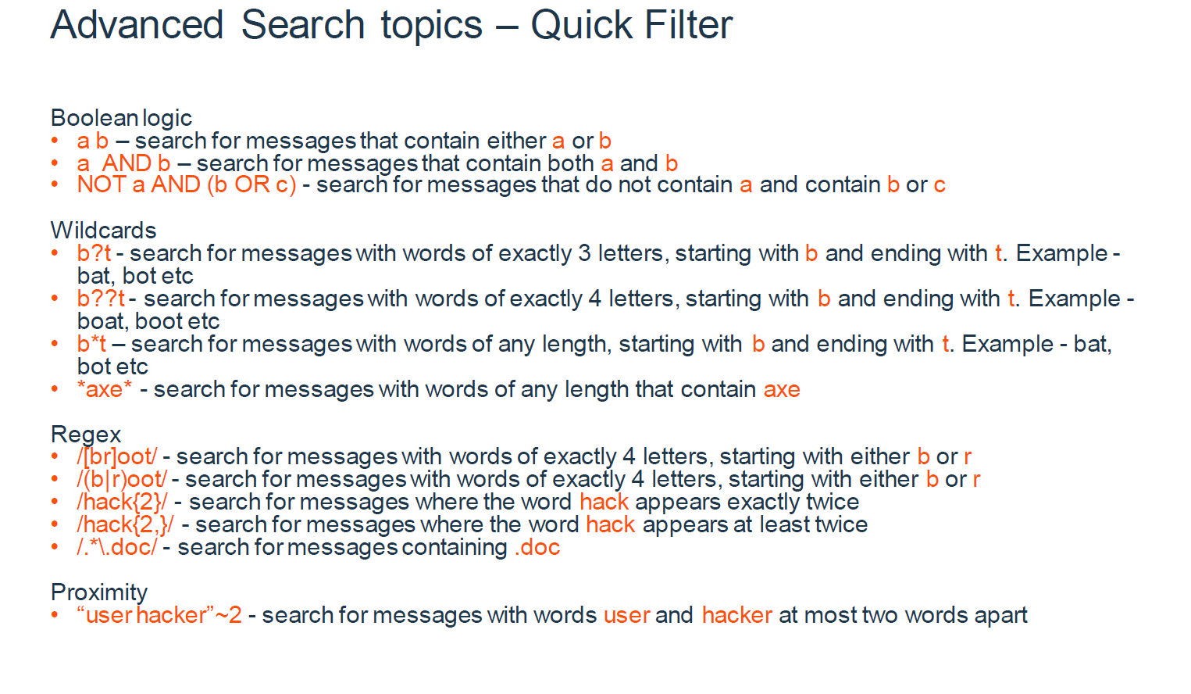

Slide 13
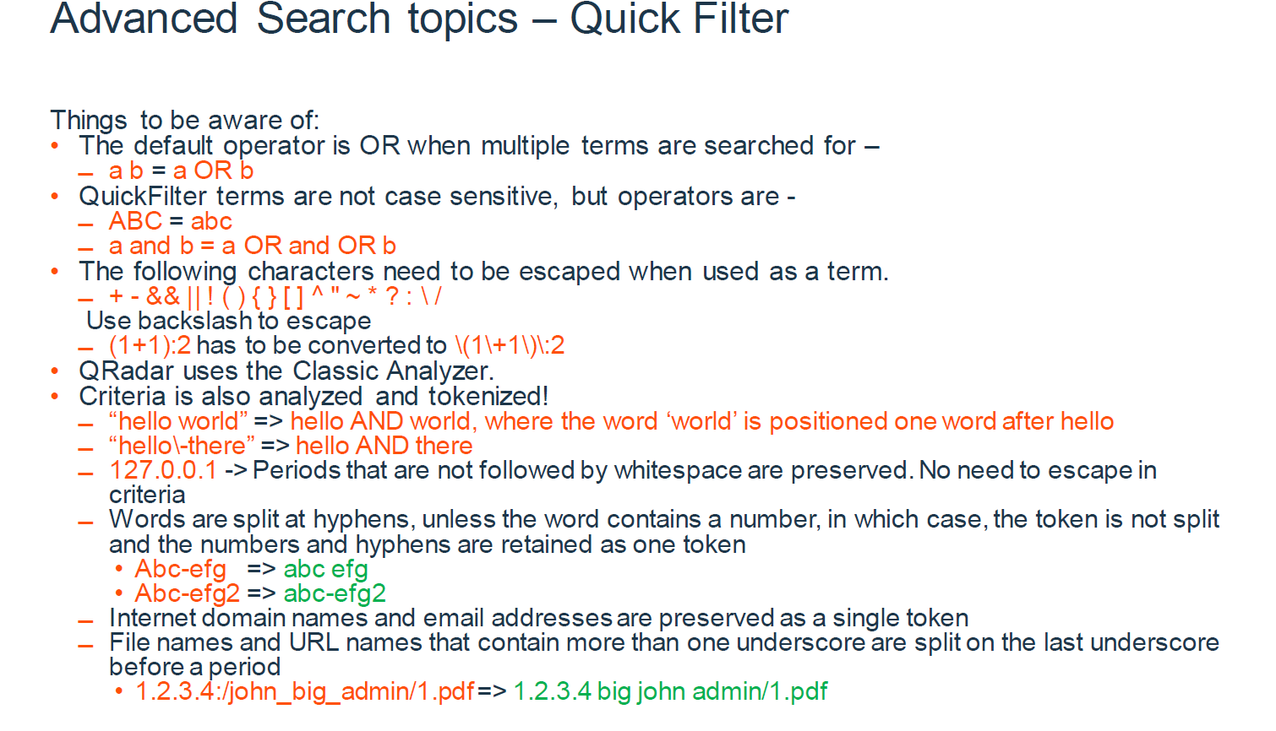

Slide 14
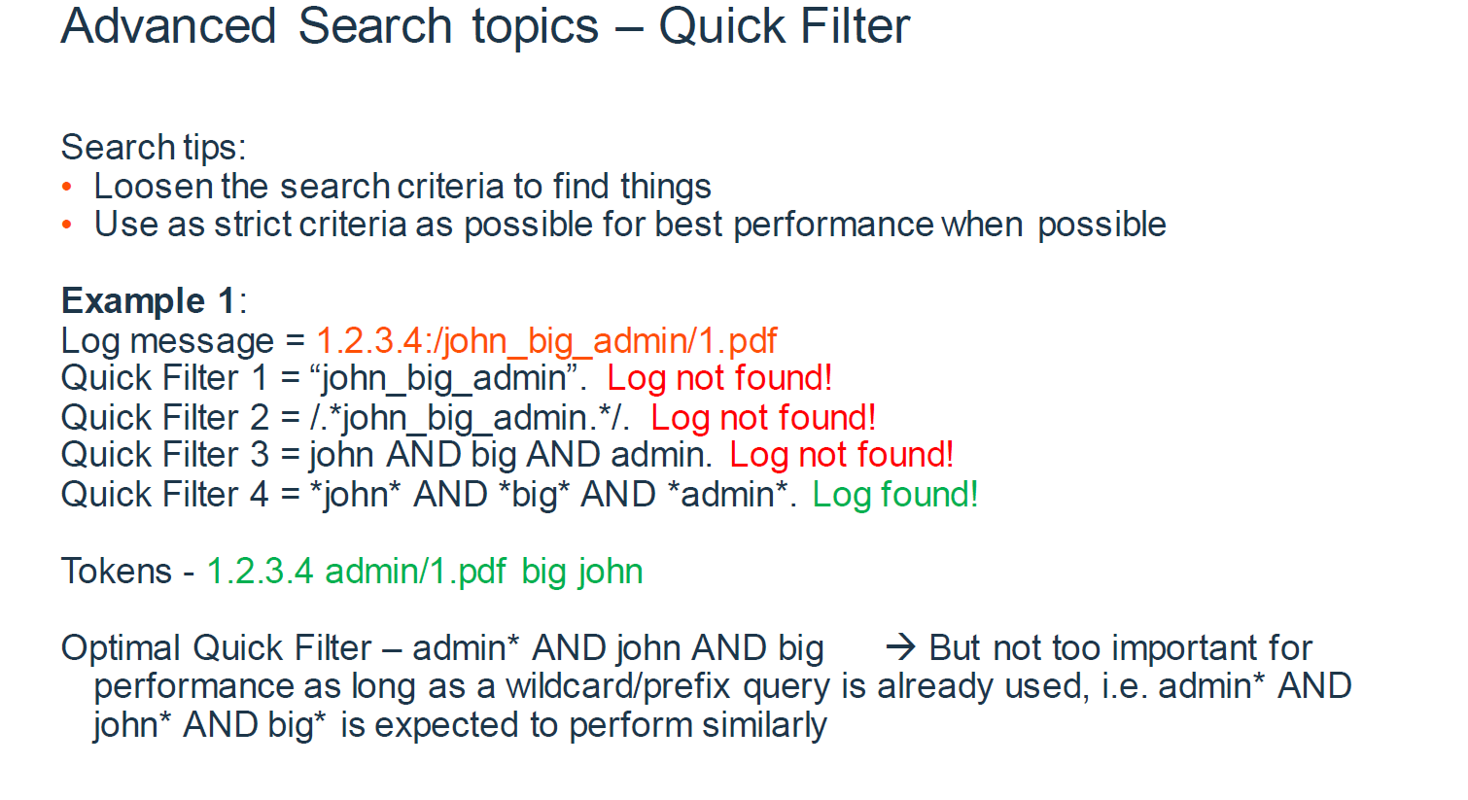

Slide 15
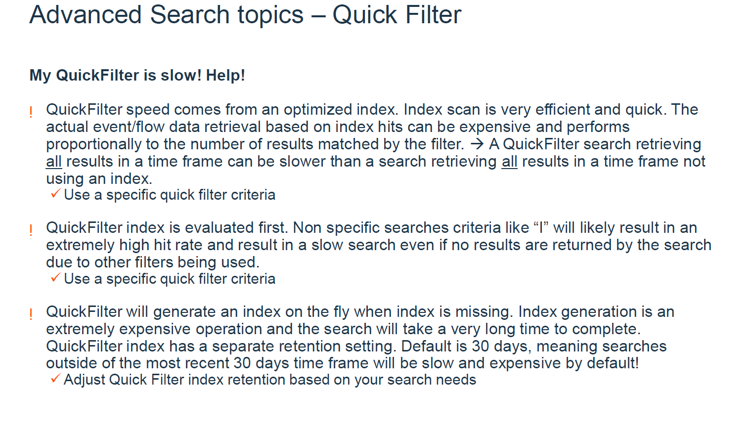

Slide 16
THANK
YOU!
Petromir Ivanov | Manager Enterprise infrastructure solutions and services departmentSenior, CNSYS PLC

